Slide 1
COVID-19 Management System
Dave Anderson (team leader),
Zhuojing Xie, David Nguyen​

Slide 2
CONTENTS
Overview & Our Mission
Console Demonstration
Web
Q&A

Slide 3
Problem
Since March 2020, COVID-19 has turned the United States upside down. Although there could have been more effective measures early in the pandemic, state governments now find themselves in a great need to track COVID-19's spread within local governments and analyze statistics to fight back. This includes creating testing facilities, tracking cases, and coordination with labs and hospitals to deal with the massive expected flux of patients and tests.

Slide 4
Our mission
Help health care systems properly manage and observe the ongoingCOVID-19 Pandemic by providing organize statistics and information about the spreading of the virus

Slide 5
Pandemic Analyse
Inventory control
Allow State Health Dept to monitor the latest pandemic status
Help Hospital to monitor the medical supplies inventory
Hotspot warning
Case check
Warining individual to avoiding visiting high risk place
Follow up each case to find best cure to fight back COVID 19

Slide 6
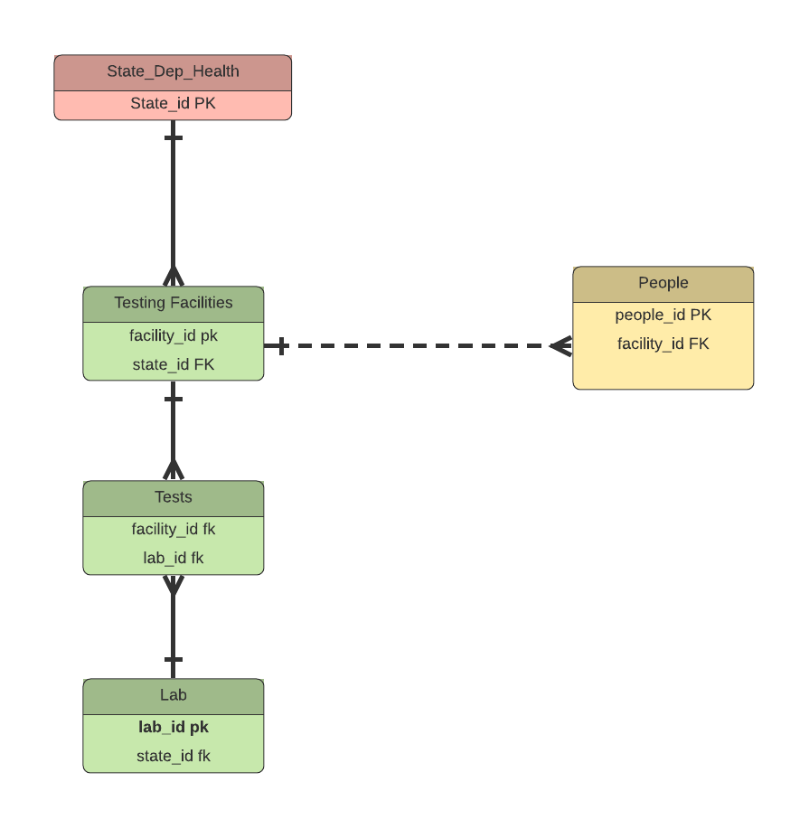
Testing Facilities View
Feeds
Testing
Send
Return

Slide 7
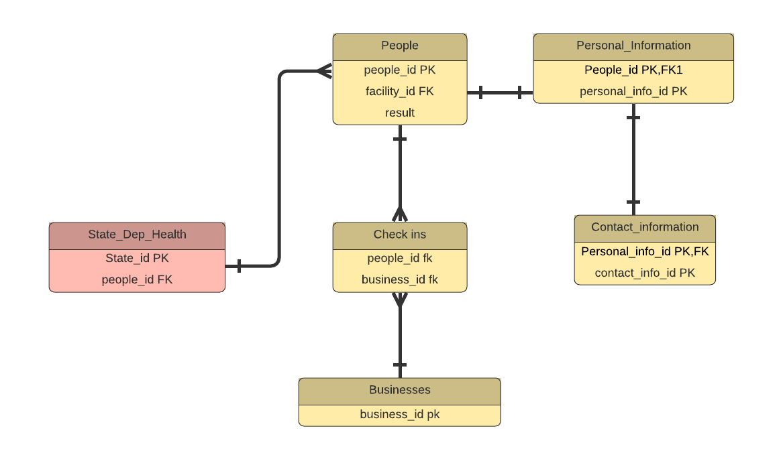
Testing Facilities View
Contains
SDH gives warning if people contacted infected
Retur

Slide 8
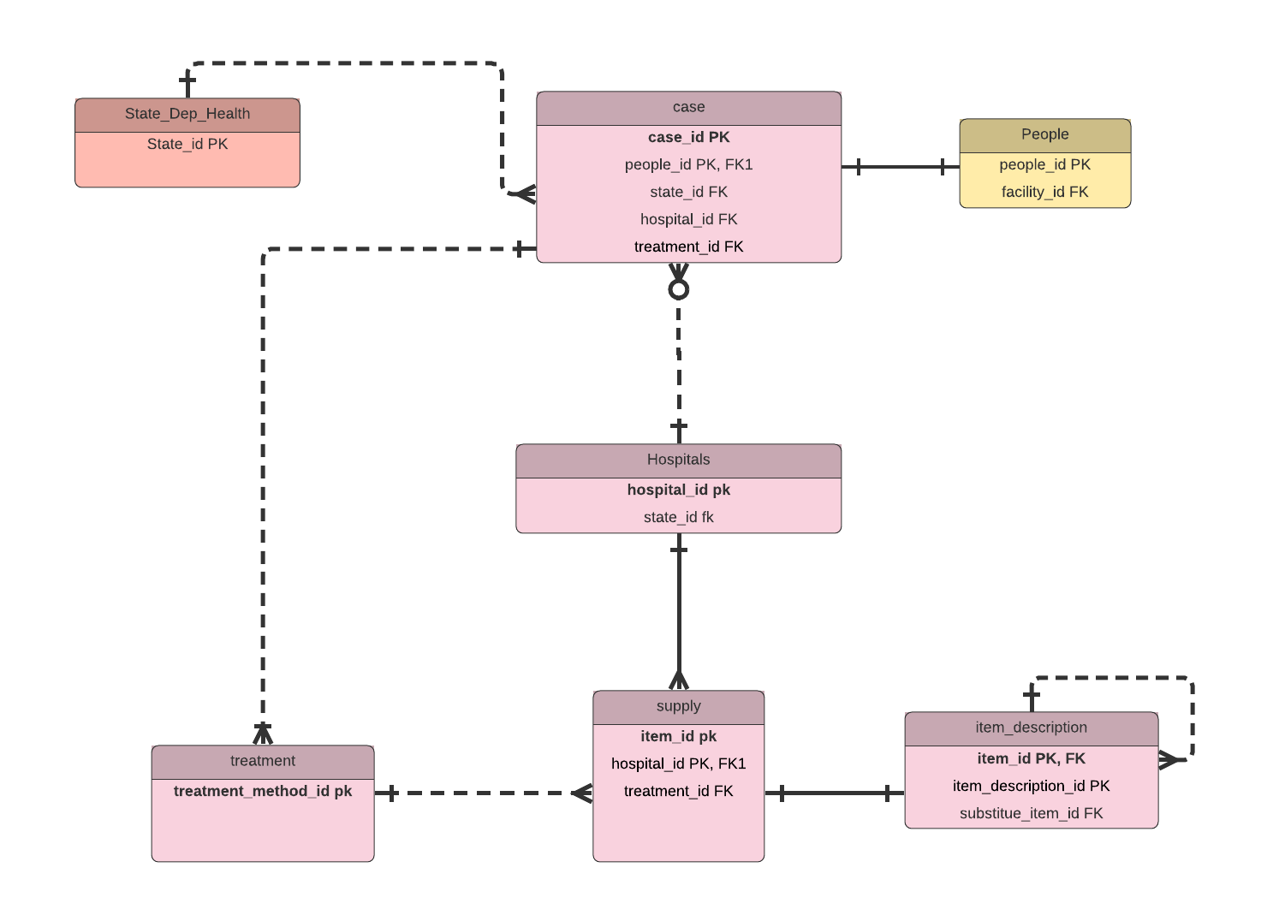
Hospital View
One item could have multiple substitution items

Slide 9
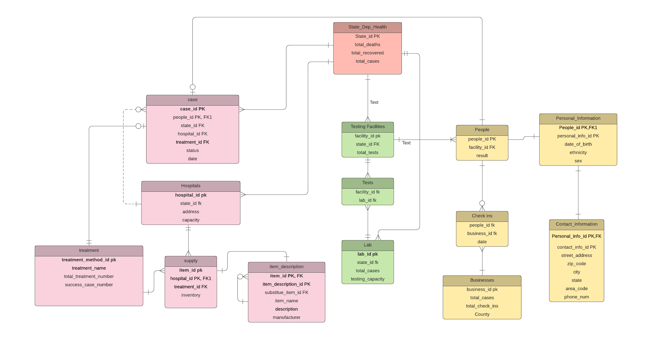
Conceptual Model

Slide 10
Q&A ?

